Slide 1

AI 芯片
— GPU 详解
Tensor Core
深度剖析
ZOMI

Slide 2
Talk Overview
硬件基础
GPU 工作原理
GPU AI编程本质
英伟达 GPU 架构
GPU基础概念
从 Fermi 到 Volta 架构
Turing 到 Hopper 架构
Tensor Code 和 NVLink 详解
GPU 图形处理
GPU 逻辑模块划分
算法到 GPU 硬件
GPU 的软件栈
图形流水线基础
流水线不可编译单元
光线跟踪流水线

Slide 3
Talk Overview
工作原理
Tensor Core – Tensor Core 执行
Instruction Pipeline – 指令流水
CUDA Thread – CUDA 线程执行

Slide 4
Tensor Core
执行

Slide 5
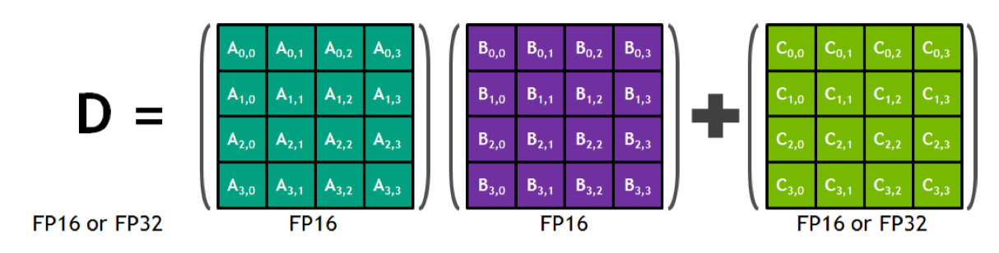
Tensor Core
FMA: D=A*B+C
$$D_{0,0}=A_{0,0}∗B_{0,0}+A_{0,1}∗B_{1,0}+A_{0,2}∗B_{2,0}+A_{0,3}∗B_{3,0}+C_{0,0}$$

Slide 6
Tensor Core
$$D_{0,0}=A_{0,0}∗B_{0,0}+A_{0,1}∗B_{1,0}+A_{0,2}∗B_{2,0}+A_{0,3}∗B_{3,0}+C_{0,0}$$
$$D_{1,1}=A_{1,0}∗B_{0,1}+A_{1,1}∗B_{1,1}+A_{1,2}∗B_{2,1}+A_{1,3}∗B_{3,1}+C_{1,1}$$

Slide 7
Tensor Core
$$D_{0,0}=A_{0,0}∗B_{0,0}+A_{0,1}∗B_{1,0}+A_{0,2}∗B_{2,0}+A_{0,3}∗B_{3,0}+C_{0,0}$$
$$D_{1,1}=A_{1,0}∗B_{0,1}+A_{1,1}∗B_{1,1}+A_{1,2}∗B_{2,1}+A_{1,3}∗B_{3,1}+C_{1,1}$$
$$…$$
$$D_{3,3}=A_{3,0}∗B_{0,3}+A_{3,1}∗B_{1,3}+A_{3,2}∗B_{2,3}+A_{3,3}∗B_{3,3}+C_{3,3}$$

Slide 8
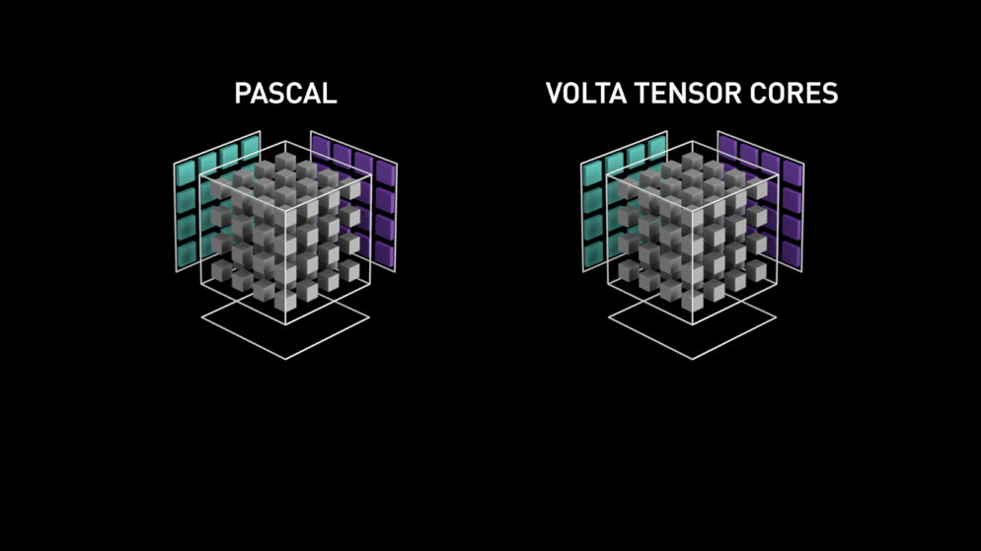
Tensor Core 单时钟周期内能执行 4×4×4=64 次 FMA（Fused-Multiply-Add，乘加计算）

Slide 9
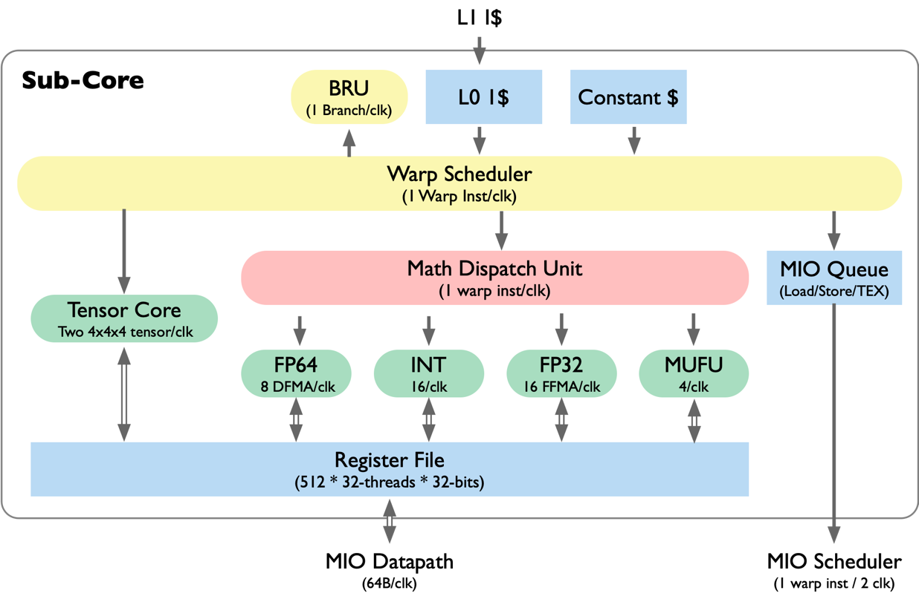
VOLTA Sub-Core 微架构
Warp Scheduler
1 Warp instr/clk
L0 I$, branch unit
Math Dispatch Unit
Keeps 2+ Datapaths Busy
MIO Instruction Queue
Hold for later Scheduling
Tensor Cores
Two 4x4x4 matric

Slide 10
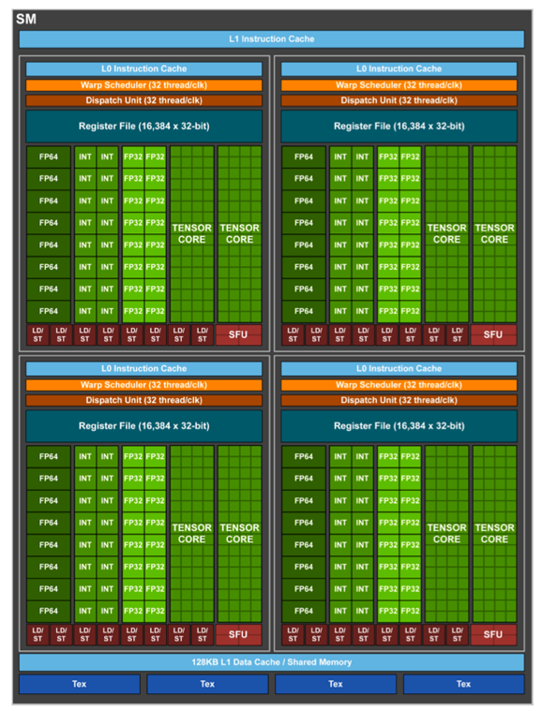
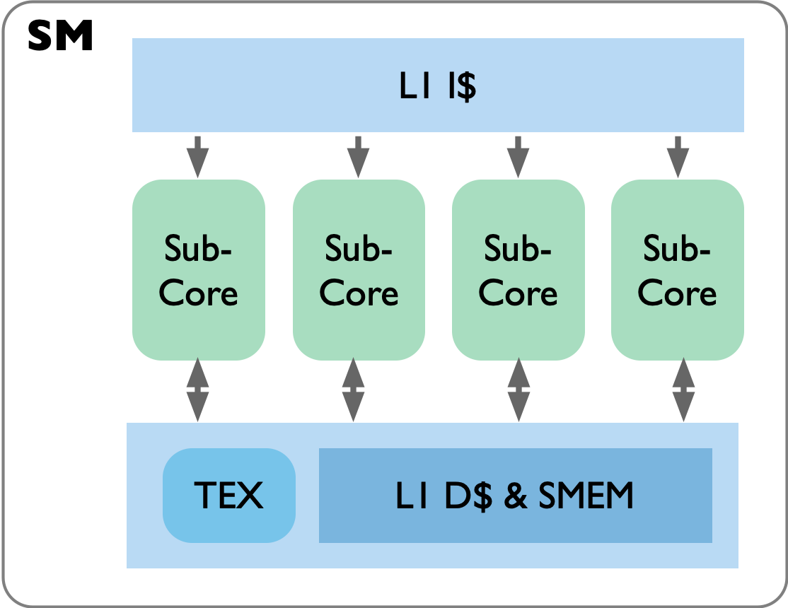
VOLTA SM

Slide 11
Tensor Core
指令流水

Slide 12
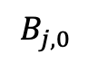

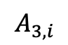
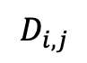
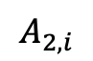
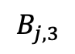
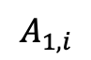
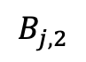
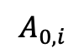
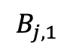
High Level Block Diagram
$$C_{i,j}$$
+
+
+
+
$$D_{i,j}$$
X
X
X
X
$$A_{0,i}$$
$$B_{j,0}$$
$$A_{1,i}$$
$$B_{j,1}$$
$$A_{2,i}$$
$$B_{j,2}$$
$$A_{3,i}$$
$$B_{j,3}$$
$$D_{0,0}=A_{0,0}∗B_{0,0}+A_{0,1}∗B_{1,0}+A_{0,2}∗B_{2,0}+A_{0,3}∗B_{3,0}+C_{0,0}$$

Slide 13

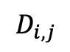
High Level Block Diagram
32bit
$$C_{i,j}$$
$$D_{i,j}$$
32bit
+
+
+
+
X
X
X
X
$$A_{0,i}$$
$$B_{j,0}$$
$$A_{1,i}$$
$$B_{j,1}$$
$$A_{2,i}$$
$$B_{j,2}$$
$$A_{3,i}$$
$$B_{j,3}$$
16bit
16bit
16bit
16bit
16bit
16bit
16bit
16bit
$$D_{0,0}=A_{0,0}∗B_{0,0}+A_{0,1}∗B_{1,0}+A_{0,2}∗B_{2,0}+A_{0,3}∗B_{3,0}+C_{0,0}$$

Slide 14
High Level Block Diagram
32bit
$$C_{i,j}$$
$$D_{i,j}$$
32bit
+
+
+
+
X
X
X
X
$$A_{0,i}$$
$$B_{j,0}$$
$$A_{1,i}$$
$$B_{j,1}$$
$$A_{2,i}$$
$$B_{j,2}$$
$$A_{3,i}$$
$$B_{j,3}$$
16bit
16bit
16bit
16bit
16bit
16bit
16bit
16bit
$$D_{0,0}=A_{0,0}∗B_{0,0}+A_{0,1}∗B_{1,0}+A_{0,2}∗B_{2,0}+A_{0,3}∗B_{3,0}+C_{0,0}$$

Slide 15
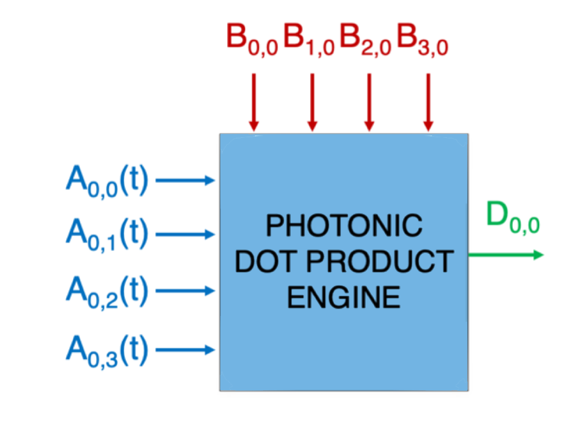
High Level Block Diagram

Slide 16
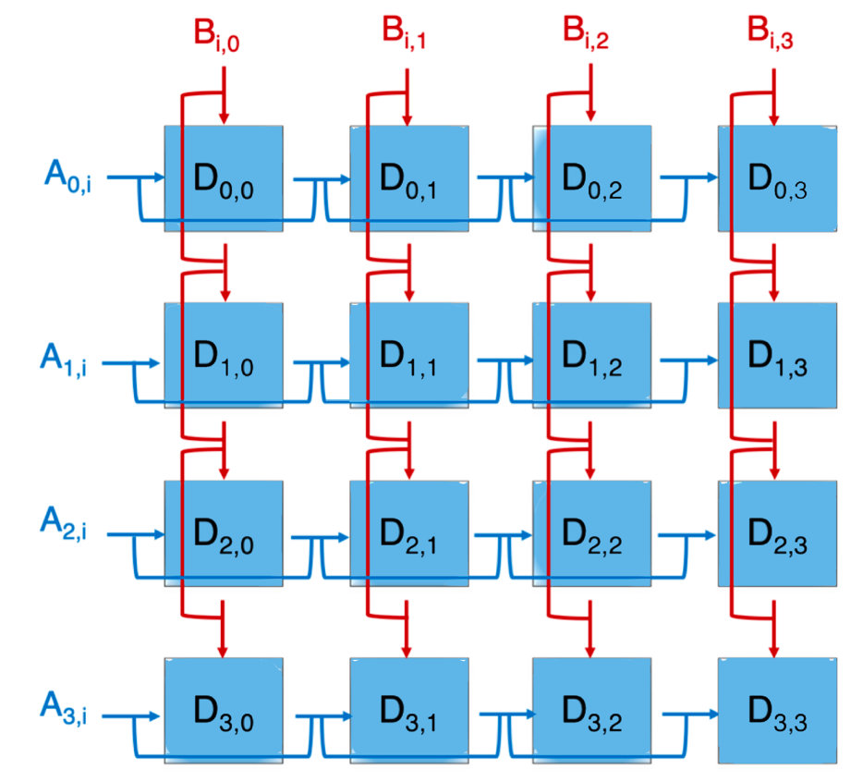
High Level Block Diagram

Slide 17
指令流水
uInstruct
Mul 0
Mul 0
Add 0
Add 1
Round
Time

Slide 18
指令流水
Mul 0
Add 0
Add 1
Round

Slide 19
指令流水
Mul 0
Add 0
Add 1
Round
Mul 0
Add 0
Add 1
Round

Slide 20
指令流水
Mul 0
Add 0
Add 1
Mul 0
Add 0
Add 1
Mul 0
Add 0
Add 1
Mul 0
Add 0
Add 1
Round

Slide 21
指令流水
Mul 0
Add 0
Add 1
Mul 0
Add 0
Add 1
Mul 0
Add 0
Add 1
Mul 0
Add 0
Add 1
Mul 0
Add 0
Add 1
Mul 0
Add 0
Add 1
Round
Mul 0
Add 0
Add 1
Mul 0
Add 0
Add 1
Round

Slide 22
指令流水
Mul 0
Add 0
Add 1
Mul 0
Add 0
Add 1
Mul 0
Add 0
Add 1
Mul 0
Add 0
Add 1
Mul 0
Add 0
Add 1
Mul 0
Add 0
Add 1
Round
Mul 0
Add 0
Add 1
Mul 0
Add 0
Add 1
Mul 0
Add 0
Add 1
Mul 0
Add 0
Add 1
Round
Mul 0
Add 0
Add 1
Mul 0
Add 0
Add 1
Mul 0
Add 0
Add 1
Mul 0
Add 0
Add 1
Round
Mul 0
Add 0
Add 1
Mul 0
Add 0
Add 1
Mul 0
Add 0
Add 1
Mul 0
Add 0
Add 1
Round
Mul 0
Add 0
Add 1
Mul 0
Add 0
Add 1
Round

Slide 23
Add 1
Mul 0
Add 0
Add 1
Round
Mul 0
Add 0
Add 1
Add 0
Add 1
Mul 0
Add 0
Add 1
Round
Mul 0
Add 0
Add 1
Mul 0
Add 0
Add 1
Mul 0
Add 0
Add 1
Round
Mul 0
Add 0
Add 1
Mul 0
Add 0
Add 1
Mul 0
Add 0
Add 1
Mul 0
Add 0
Add 1
Mul 0
Add 0
Add 1
Round
Mul 0
Add 0
Add 1
Mul 0
Add 0
Add 1
Mul 0
Add 0
Add 1
Mul 0
Add 0
Add 1
Round
Mul 0
Add 0
Add 1
Mul 0
Add 0
Add 1
Mul 0
Add 0
Add 1
Mul 0
Add 0
Add 1
Round
Mul 0
Add 0
Add 1
Mul 0
Add 0
Add 1
Mul 0
Add 0
Add 1
Mul 0
Add 0
Add 1
Round
Mul 0
Add 0
Add 1
Mul 0
Add 0
Add 1
Mul 0
Add 0
Add 1
Mul 0
Add 0
Add 1
Mul 0
Add 0
Add 1
Mul 0
Add 0
Add 1
Mul 0
Add 0
Add 1
Mul 0
Add 0
Mul 0
Add 0
Add 1
Mul 0
Add 0
Add 1
Mul 0
Add 0
Add 1
Mul 0

Slide 24
Add 1
Mul 0
Add 0
Add 1
Round
Mul 0
Add 0
Add 1
Add 0
Add 1
Mul 0
Add 0
Add 1
Round
Mul 0
Add 0
Add 1
Mul 0
Add 0
Add 1
Mul 0
Add 0
Add 1
Round
Mul 0
Add 0
Add 1
Mul 0
Add 0
Add 1
Mul 0
Add 0
Add 1
Mul 0
Add 0
Add 1
Mul 0
Add 0
Add 1
Round
Mul 0
Add 0
Add 1
Mul 0
Add 0
Add 1
Mul 0
Add 0
Add 1
Mul 0
Add 0
Add 1
Round
Mul 0
Add 0
Add 1
Mul 0
Add 0
Add 1
Mul 0
Add 0
Add 1
Mul 0
Add 0
Add 1
Round
Mul 0
Add 0
Add 1
Mul 0
Add 0
Add 1
Mul 0
Add 0
Add 1
Mul 0
Add 0
Add 1
Round
Mul 0
Add 0
Add 1
Mul 0
Add 0
Add 1
Mul 0
Add 0
Add 1
Mul 0
Add 0
Add 1
Mul 0
Add 0
Add 1
Mul 0
Add 0
Add 1
Mul 0
Add 0
Add 1
Mul 0
Add 0
Mul 0
Add 0
Add 1
Mul 0
Add 0
Add 1
Mul 0
Add 0
Add 1
Mul 0

Slide 25
Add 1
Mul 0
Add 0
Add 1
Round
Mul 0
Add 0
Add 1
Add 0
Add 1
Mul 0
Add 0
Add 1
Round
Mul 0
Add 0
Add 1
Mul 0
Add 0
Add 1
Mul 0
Add 0
Add 1
Round
Mul 0
Add 0
Add 1
Mul 0
Add 0
Add 1
Mul 0
Add 0
Add 1
Mul 0
Add 0
Add 1
Mul 0
Add 0
Add 1
Round
Mul 0
Add 0
Add 1
Mul 0
Add 0
Add 1
Mul 0
Add 0
Add 1
Mul 0
Add 0
Add 1
Round
Mul 0
Add 0
Add 1
Mul 0
Add 0
Add 1
Mul 0
Add 0
Add 1
Mul 0
Add 0
Add 1
Round
Mul 0
Add 0
Add 1
Mul 0
Add 0
Add 1
Mul 0
Add 0
Add 1
Mul 0
Add 0
Add 1
Round
Mul 0
Add 0
Add 1
Mul 0
Add 0
Add 1
Mul 0
Add 0
Add 1
Mul 0
Add 0
Add 1
Mul 0
Add 0
Add 1
Mul 0
Add 0
Add 1
Mul 0
Add 0
Add 1
Mul 0
Add 0
Mul 0
Add 0
Add 1
Mul 0
Add 0
Add 1
Mul 0
Add 0
Add 1
Mul 0

Slide 26
Tensor Core
线程执行

Slide 27
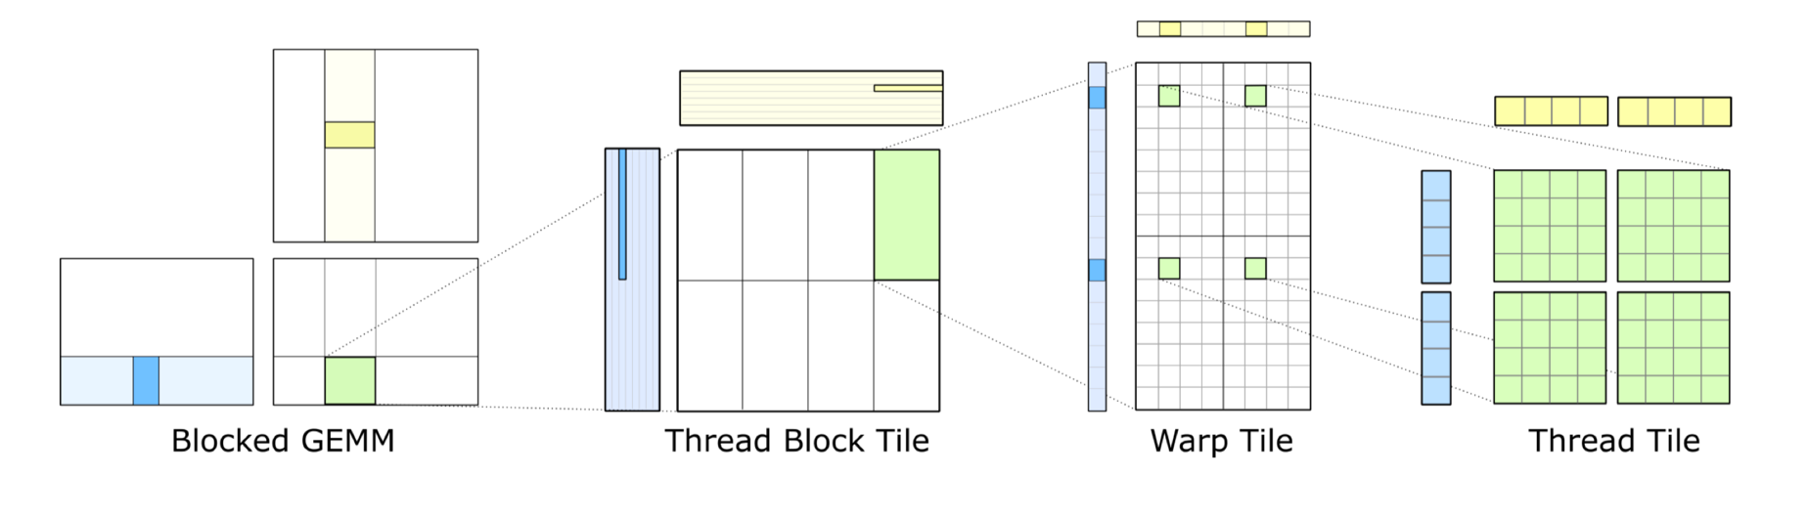

软件设计目标：匹配硬件计算和存储分层结构
基于CUDA提供泛型编程 Generic Programing
$$C=A×B$$

Slide 28
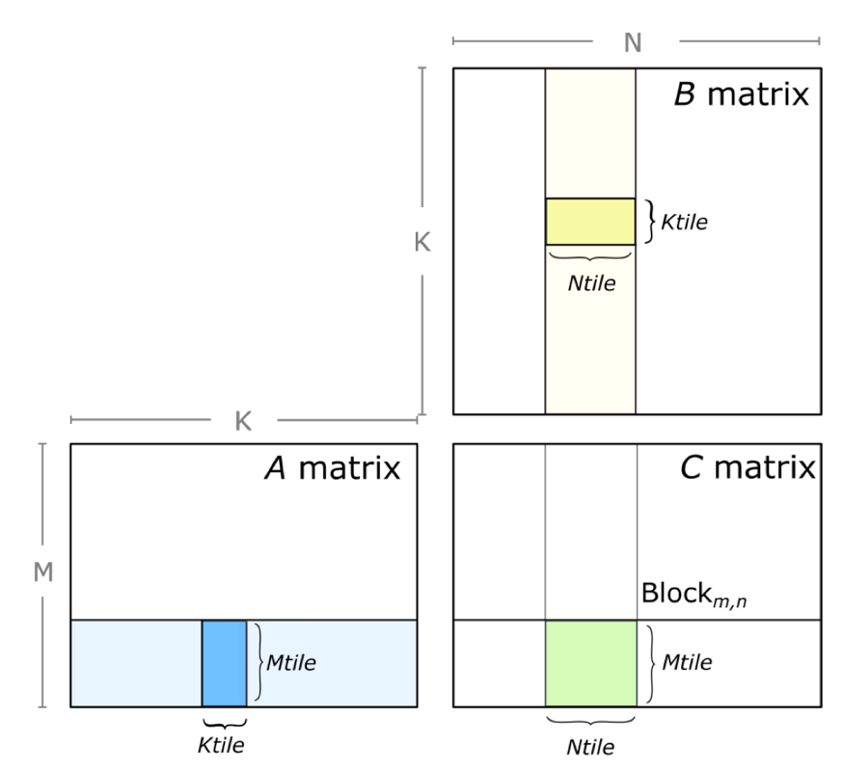
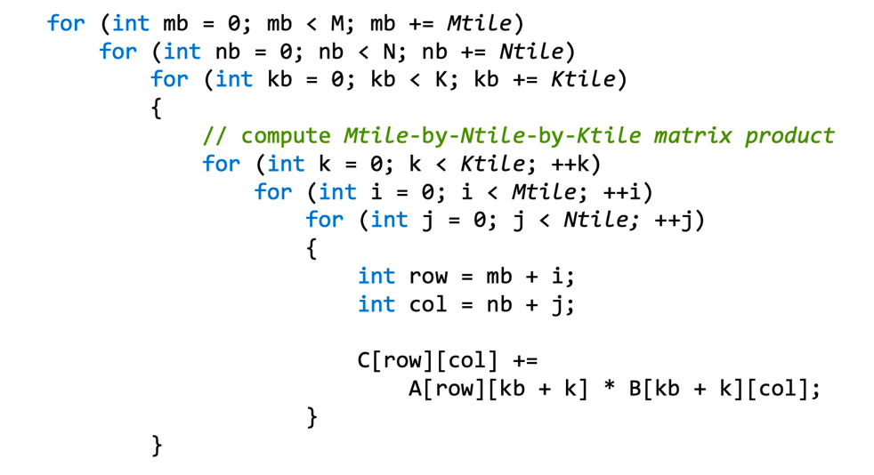
通用的矩阵乘：一次计算一个矩阵块
沿每个维度将循环嵌套 Loop nest 划分为块 blocks
划分成为 Mtile-by-Ntile 的独立矩阵乘
通过累积 Mtile-by-Ntile-by-Ktile 的矩阵乘积来计算每个乘积

Slide 29
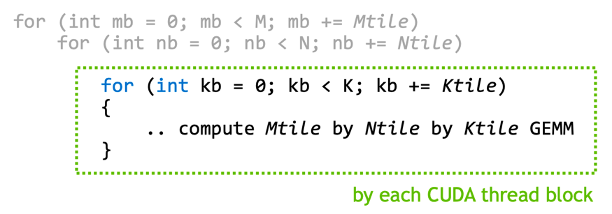
CUDA中的GEMM：在CUDA线程块中并行
使用 CUDA kernel grid
将 CUDA 线程块分配给输出矩阵 D 的每个分区
CUDA 线程块并行计算 Mtile-by-Ntile-by-Ktile 矩阵乘
在 K 维上进行迭代，执行累积 Mtile-by-Ntile-by-Ktile 矩阵乘的结果

Slide 30
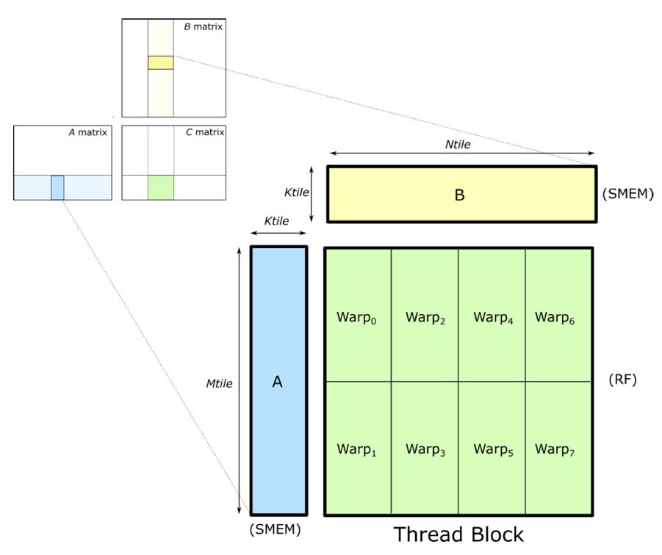
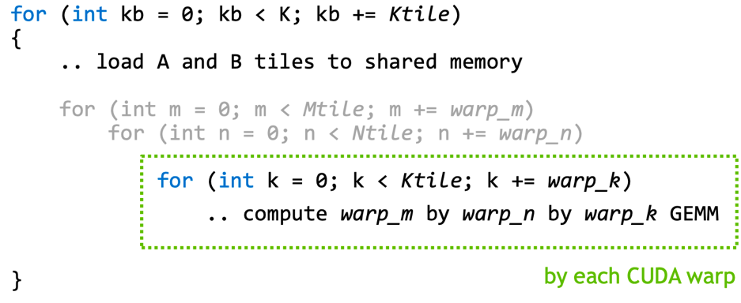
线程块：CUDA线程块内的并行性
将线程块 Thread block 分解为 warp-level Tiles
把矩阵 A 和 B 加载到可复用的 SMEM 共享内存
结果矩阵 C 分布在不同的 Warp 上
每个 warp 计算一个独立的矩阵乘

Slide 31
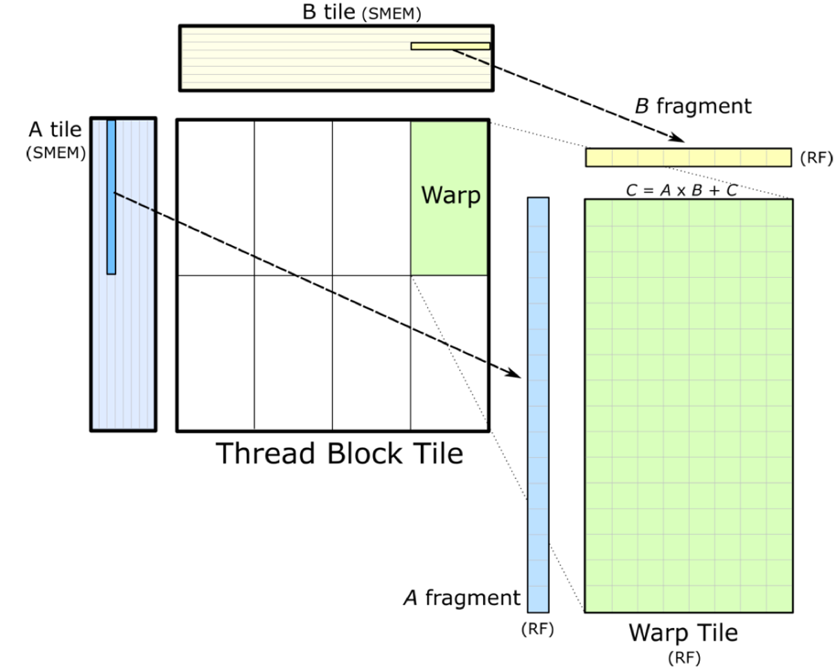
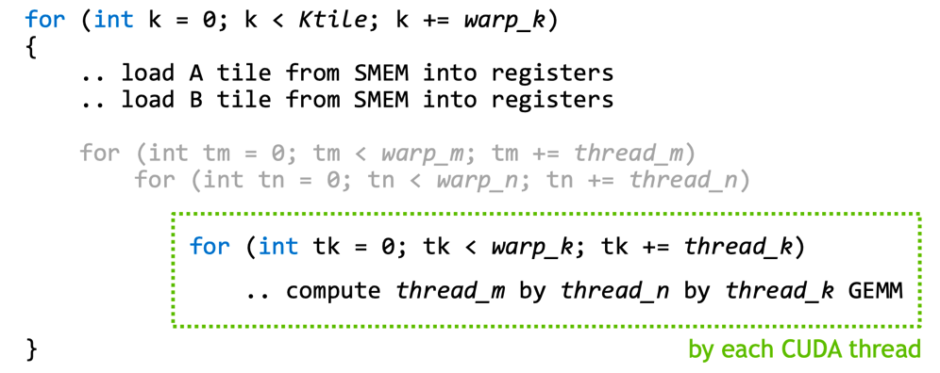
Warp-level 的矩阵乘
Warps-level 来真正执行累积的矩阵乘
把 fragment 矩阵 A 和 B 从共享内存加载到寄存器
SMEM to RF: 数据加载要快于计算，否则阻塞
结果矩阵 C 存在线程参与执行的寄存器上
SMEM共享内存 以 K 维排序，线程高效
WMMA GEMM:
64-by-32-by-16

Slide 32
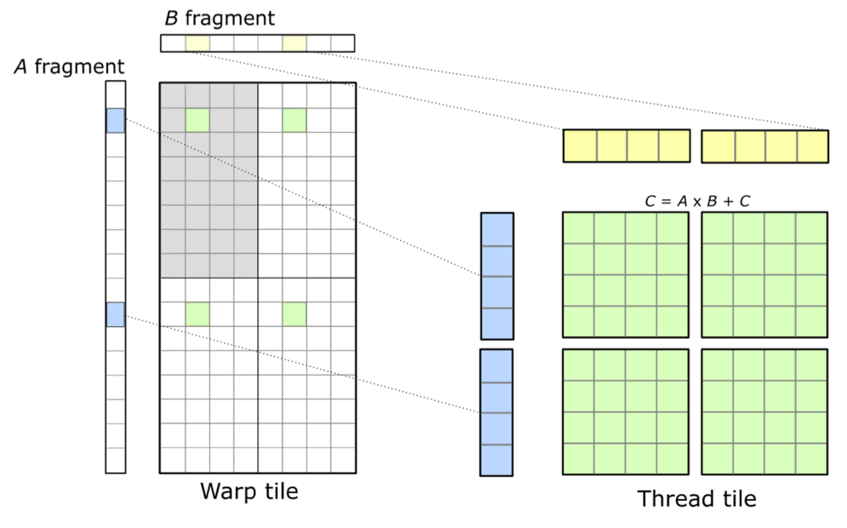
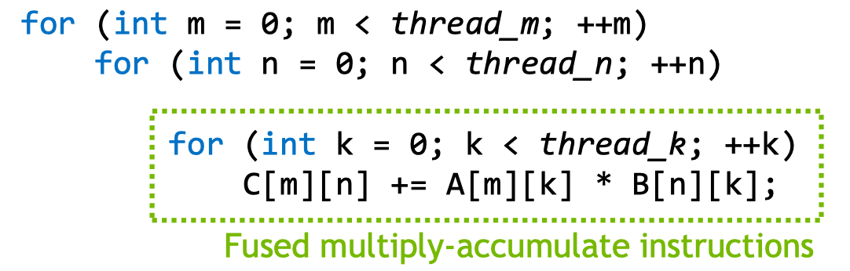
线程-level：Tensor Core上并行执行
Threads 累积的矩阵乘
A、B、C 矩阵都在寄存器上

Slide 33
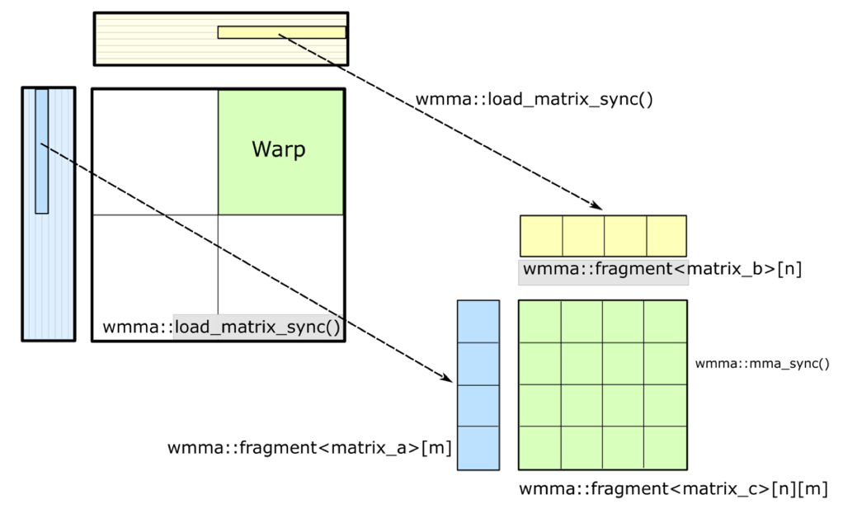
线程-level：Tensor Core上并行执行
Threads 累积的矩阵乘
A、B、C 矩阵都在寄存器上

Slide 34
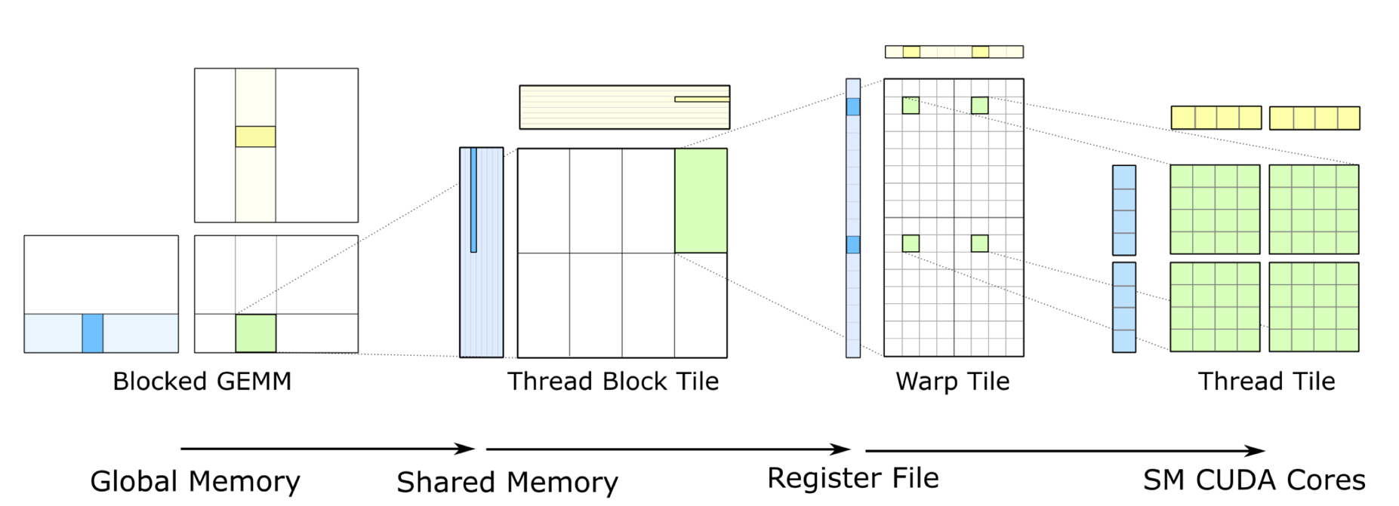
GEMM软硬件分层：每一层都进行数据复用

Slide 35
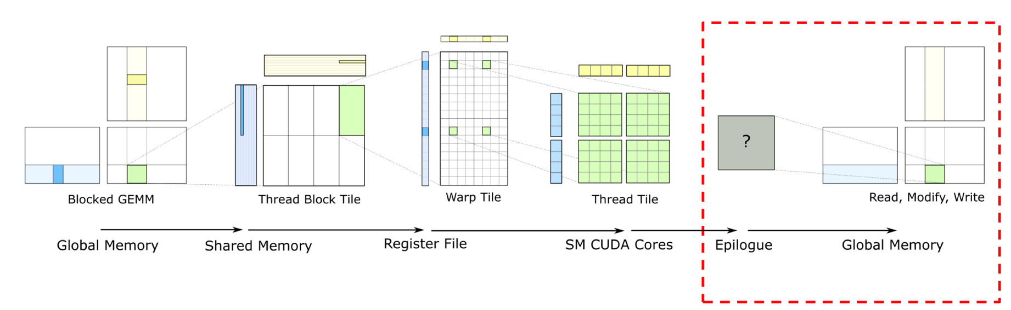
GEMM结束：如何把累积矩阵乘写出最终结果

Slide 36
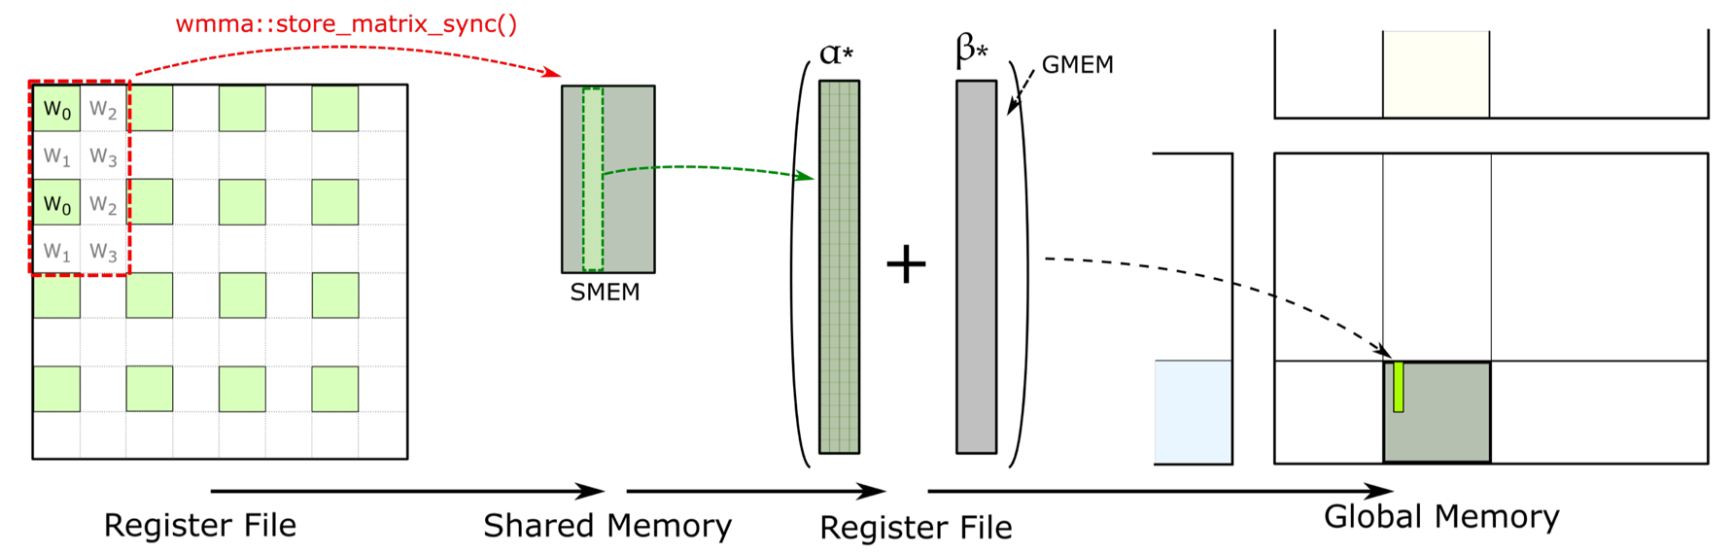
WMMA 结果回传

Slide 37
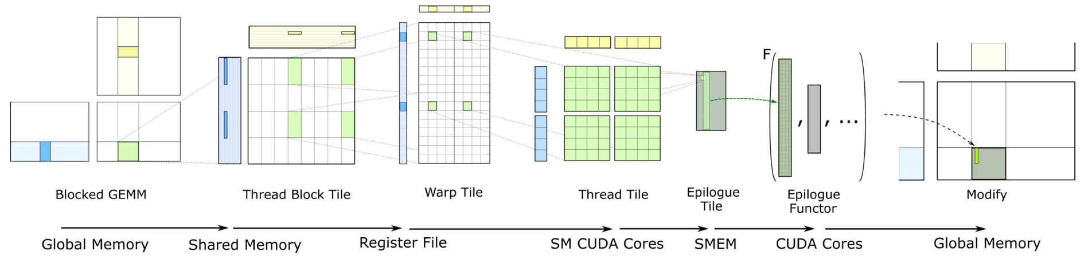
完整 GEMM 计算/存储数据流

Slide 38
Reference 引用&参考
https://zhuanlan.zhihu.com/p/620257581
https://developer.nvidia.com/blog/programming-tensor-cores-cuda-9/
https://developer.nvidia.com/blog/accelerating-winml-and-nvidia-tensor-cores/
https://developer.nvidia.com/blog/optimizing-gpu-performance-tensor-cores/
https://www.anandtech.com/Gallery/Album/6494#15
https://www.anandtech.com/Gallery/Album/6493#33
https://www.anandtech.com/show/12673/titan-v-deep-learning-deep-dive/3
https://www.anandtech.com/show/12673/titan-v-deep-learning-deep-dive/4
https://www.cnblogs.com/wujianming-110117/p/12993096.html
https://aijishu.com/a/1060000000286803#item-2
https://learnopencv.com/demystifying-gpu-architectures-for-deep-learning-part-2/

Slide 39
Notes:
39

